Slide 1

Diabetes Classification
Sumanraj C [ 2021503308]

Slide 2
INTRODUCTION
Diabetes is a chronic metabolic disorder characterized by abnormal blood glucose levels, represents a significant global health concern, with a growing prevalence and profound impact on individual health outcomes and healthcare systems worldwide
To develop a predictive model for diabetes classification utilizing a dataset comprising several key clinical and demographic features: 'Pregnancies', 'Glucose', 'BloodPressure', 'SkinThickness', 'Insulin', 'BMI', 'DiabetesPedigreeFunction', and 'Age'. These features encompass a diverse array of factors known to influence diabetes risk, progression, and prognosis.

Slide 3
METHOD
The dataset containing clinical and demographic features is obtained from kaggle.
The preprocessed dataset is split into training and test sets using a stratified approach
The random forest model build
The trained random forest model is evaluated using the test set to assess its performance in classifying diabetes types.
Grid search techniques are employed to tune the hyperparameters of the random forest model.

Slide 4
DATA COLLECTION
The dataset containing clinical and demographic features ('Pregnancies', 'Glucose', 'Blood Pressure', 'Skin thickness', 'Insulin', 'BMI', 'Diabetes Pedigree Function', 'Age') is obtained from kaggle.

Slide 5
DATA PREPROCESSING
Before training the random forest model, it is essential to perform thorough pre-processing of the dataset to ensure its quality and suitability for analysis. This section outlines the pre-processing steps undertaken, including examining column information, handling null values, and determining the distribution of the output classes.
Column Information:
Before proceeding with pre-processing, it important to examine the information contained within each column of the dataset. This involves inspecting the data types of the features (e.g., numerical, String).
For numerical features, statistical summaries such as mean, median, standard deviation, minimum, and maximum values can provide insights into their distribution and potential outliers.
Categorical features should be examined to determine the unique categories present and their respective frequencies.
Output Class Count
In classification tasks, it is essential to assess the distribution of the output classes to understand the balance or imbalance among different classes.
Counting the occurrences of each class label in the dataset helps identify any class imbalance issues that may need to be addressed during model training and evaluation.

Slide 6
DATA PREPROCESSING
Handling Null Values:​
Null values, or missing data, can adversely affect the performance of machine learning models if not appropriately addressed.​
Before proceeding with model training, it is essential to identify and handle null values in the dataset.​
Statistical Summaries:
Statistical summaries such as mean, standard deviation, minimum, maximum, and quartiles are computed for each numerical feature.
These summaries provide insights into the central tendency, spread, and distribution of the data, aiding in identifying outliers and assessing data quality.
Mean and standard deviation are particularly useful for understanding the average value and variability of each feature across the dataset.
​

Slide 7
MODEL BUILDING
Train-Test Data Splitting:
The preprocessed dataset is split into training and test sets using a stratified approach to maintain class distribution in both sets. Common ratios include 4:1 or 3:2 for training and testing, respectively.
The training set (X train, y train) consists of input features and corresponding target labels, while the test set (X test, y test) is held out for final evaluation.
Standard Scalar:
The numerical features in the training and test sets are scaled using a standard scalar to ensure that they have a mean of 0 and a standard deviation of 1.
This step facilitates model convergence and improves performance, especially for algorithms sensitive to feature scales.

Slide 8
MODEL BUILDING
Random Forest Model Building:​
A random forest classifier is instantiated using a machine learning library such as scikit-learn in Python.​
The hyperparameters of the random forest model, such as the number of trees (n estimators), maximum depth of trees (max depth), and minimum samples per leaf node (min samples leaf), are specified.​
Grid Search for Hyperparameter Tuning:​
Grid search is employed to systematically search the hyperparameter space and identify the optimal combination of hyperparameters that maximizes model performance.​
The hyperparameter combination yielding the highest cross-validated performance score is selected as the optimal set of hyperparameters for the random forest model.​

Slide 9
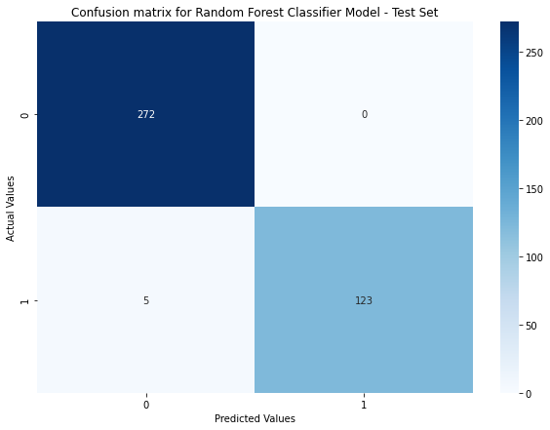
MODEL BUILDING​
Confusion matrix:
True Positive (TP): Instances that are correctly predicted as positive (diabetes) by the model.
True Negative (TN): Instances that are correctly predicted as negative (non-diabetes) by the model.
False Positive (FP): Instances that are incorrectly predicted as positive (diabetes) by the model (Type I error).
False Negative (FN): Instances that are incorrectly predicted as negative (non-diabetes) by the model (Type II error).

Slide 10
MODEL BUILDING​
Model Evaluation:​​
The trained random forest model with optimized hyperparameters is evaluated using the scaled test data (X test scaled, y test) to assess its generalization performance.​​
Evaluation metrics such as accuracy, precision, recall, F1-score, and area under the receiver operating characteristic curve (AUC-ROC) are computed to quantify the model's performance.​​
Additionally, a confusion matrix may be generated to visualize the model's predictions and compare them to the true labels in the test set.​​

